Slide 1
Unit1 / Part 2

Slide 2




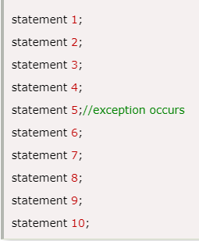

Slide 3
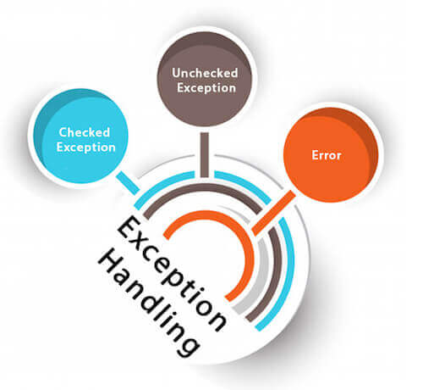

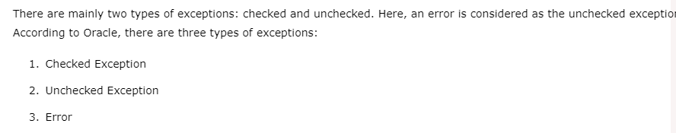
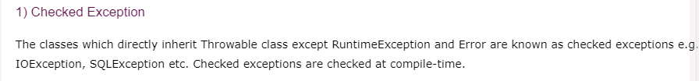
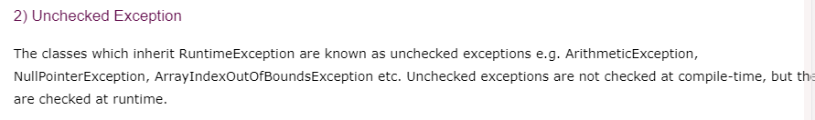


Slide 4

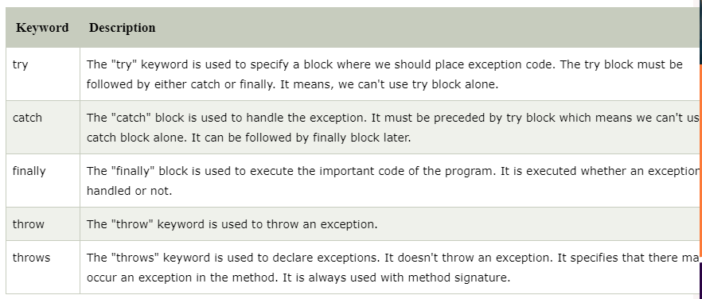

Slide 5

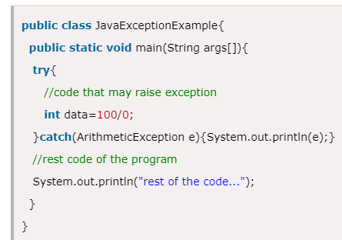


Slide 6
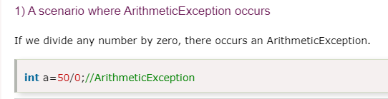
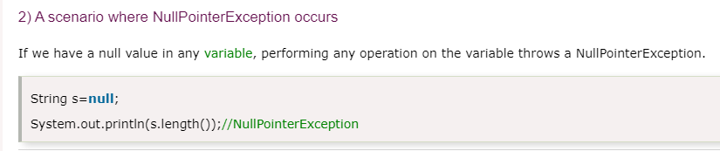

Slide 7
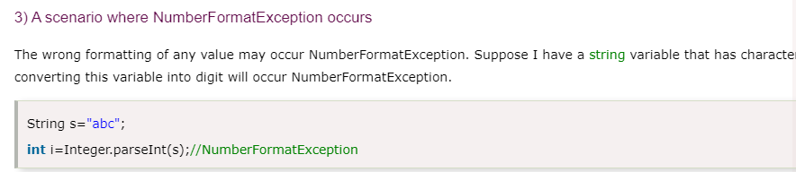
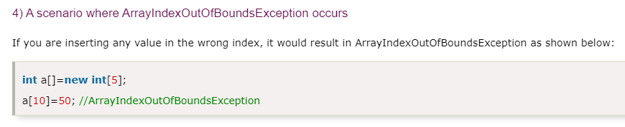

Slide 8

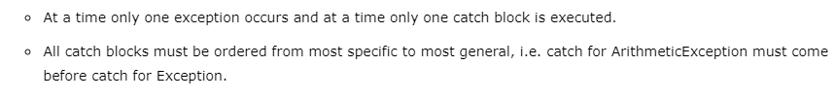
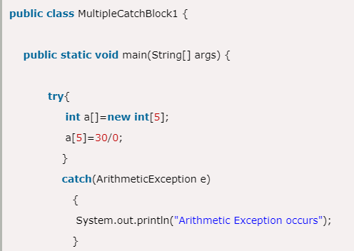
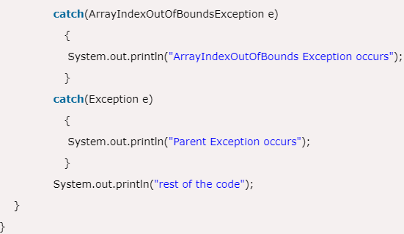


Slide 9
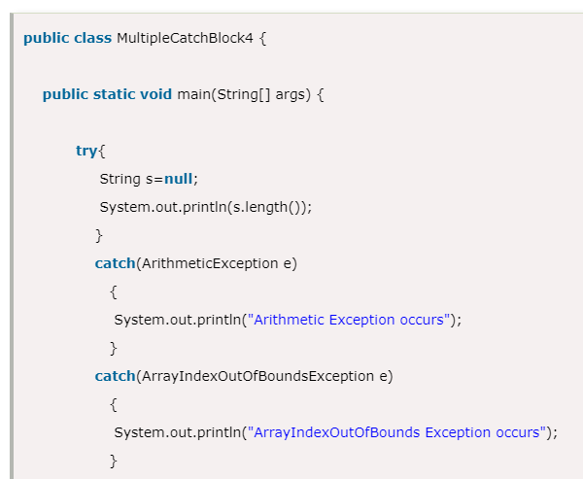
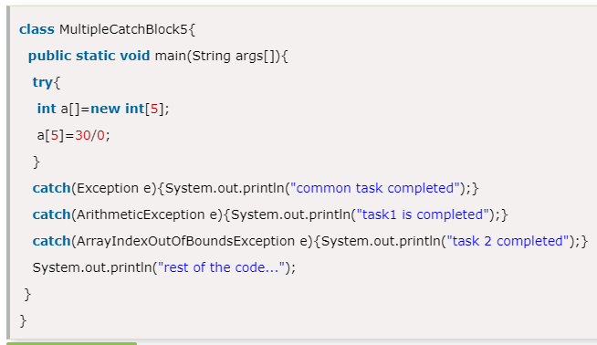


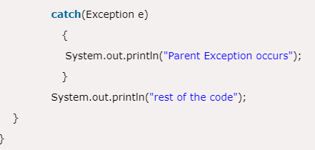

Slide 10

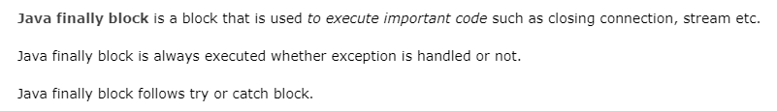
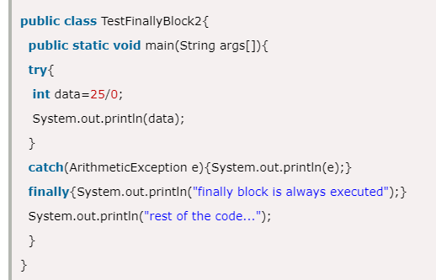



Note: If you don't handle exception, before terminating the program, JVM executes finally block(if any).
Finally block in java can be used to put "cleanup" code such as closing a file, closing connection etc.

Slide 11
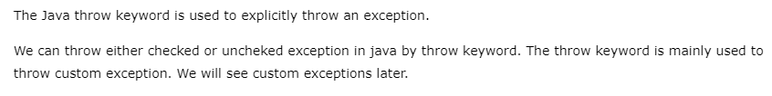

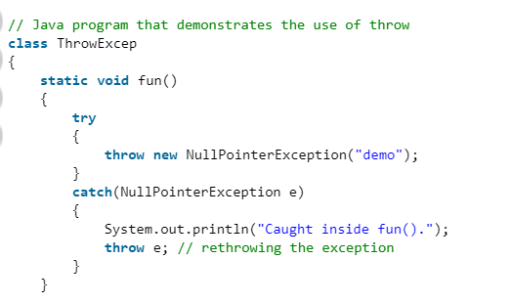
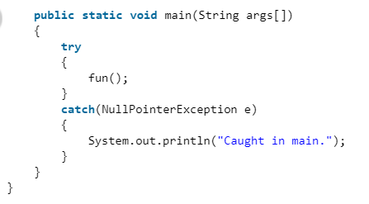
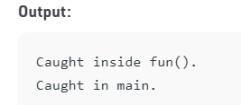

Slide 12
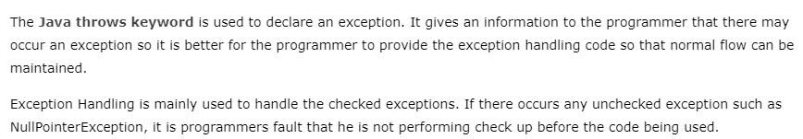

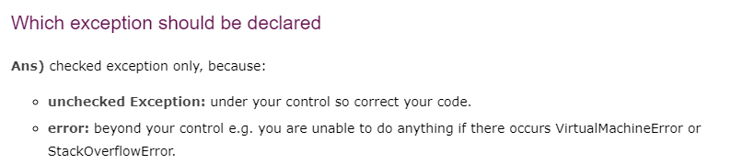
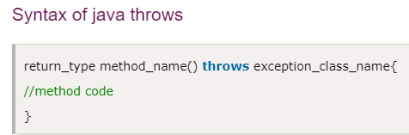
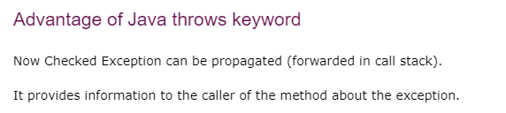

Slide 13
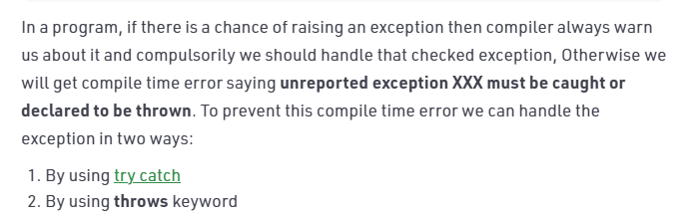
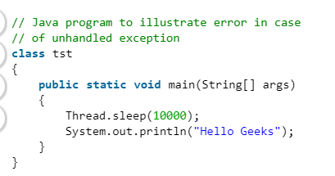
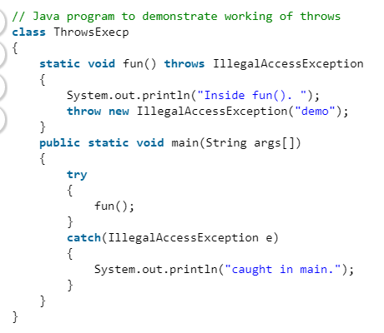
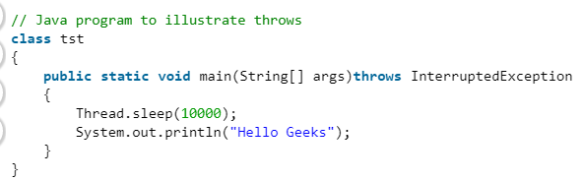
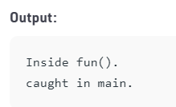

error: unreported exception InterruptedException; must be caught or declared to be thrown

Slide 14
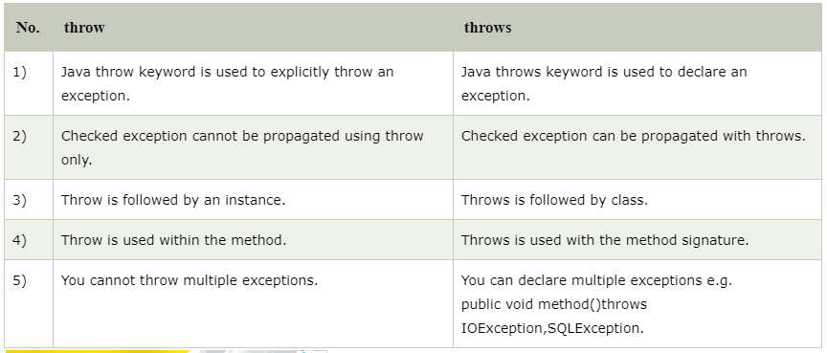

Slide 15
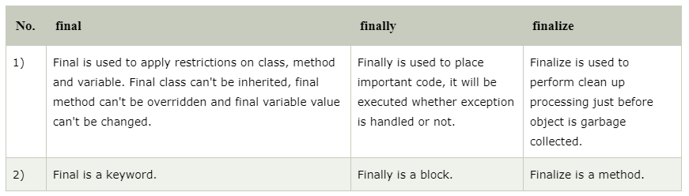
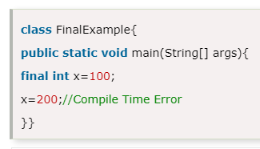

Slide 16


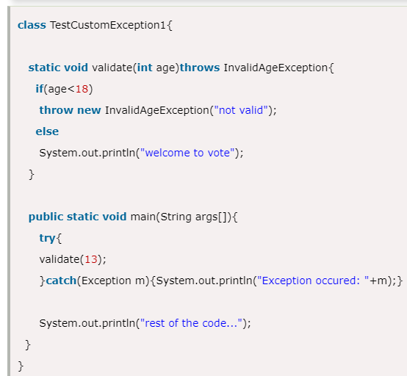
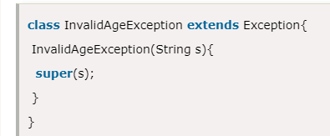


Slide 17
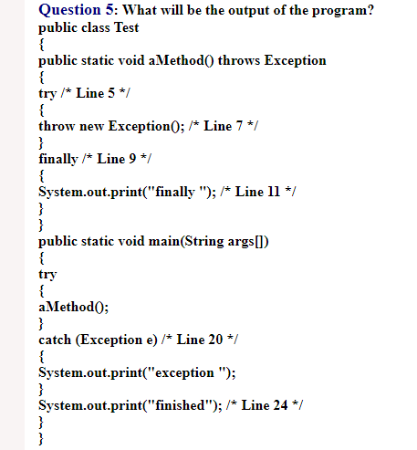

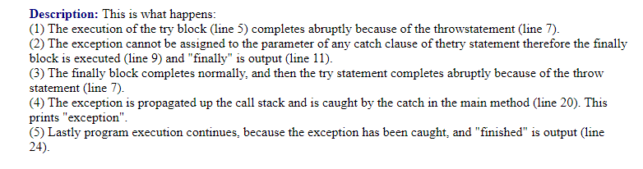
ANS : 3

Slide 18
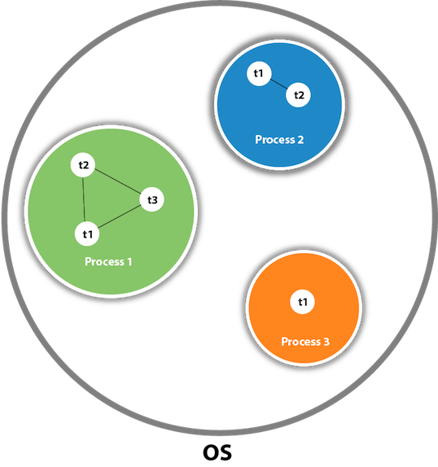
Multithreading in Java
Multithreading in java is a process of executing multiple threads simultaneously.
A thread is a lightweight sub-process, the smallest unit of processing. Multiprocessing and multithreading, both are used to achieve multitasking.
However, we use multithreading than multiprocessing because threads use a shared memory area. They don't allocate separate memory area so saves memory, and context-switching between the threads takes less time than process.
Java Multithreading is mostly used in games, animation, etc.
Advantages of Java Multithreading
1) It doesn't block the user because threads are independent and you can perform multiple operations at the same time.
2) You can perform many operations together, so it saves time.
3) Threads are independent, so it doesn't affect other threads if an exception occurs in a single thread.
What is Thread in java
A thread is a lightweight subprocess, the smallest unit of processing. It is a separate path of execution.
Threads are independent. If there occurs exception in one thread, it doesn't affect other threads. It uses a shared memory area.
As shown in the above figure, a thread is executed inside the process. There is context-switching between the threads. There can be multiple processes inside the OS, and one process can have multiple threads.

Slide 19
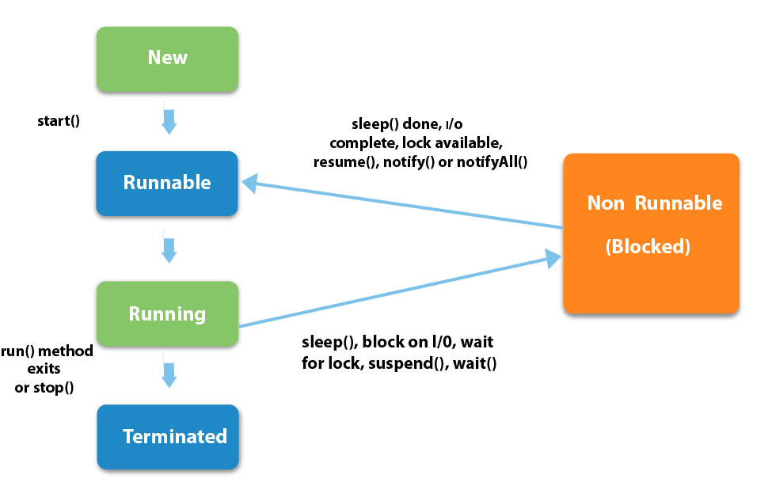
Life cycle of a Thread (Thread States)
A thread can be in one of the five states. According to sun, there is only 4 states in thread life cycle in java new, runnable, non-runnable and terminated. There is no running state.
But for better understanding the threads, we are explaining it in the 5 states.
The life cycle of the thread in java is controlled by JVM. The java thread states are as follows:
New : The thread is in new state if you create an instance of Thread class but before the invocation of start() method.
Runnable: The thread is in runnable state after invocation of start() method, but the thread scheduler has not selected it to be the running thread.
Running: The thread is in running state if the thread scheduler has selected it.
Non-Runnable (Blocked): This is the state when the thread is still alive, but is currently not eligible to run.
Terminated: A thread is in terminated or dead state when its run() method exits.

Slide 20
How to create thread
There are two ways to create a thread:
By extending Thread class
By implementing Runnable interface.
class Multi3 implements Runnable{
public void run(){
System.out.println("thread is running...");
}
public static void main(String args[]){
Multi3 m1=new Multi3();
Thread t1 =new Thread(m1);
t1.start();
}
}
class Multi extends Thread{
public void run(){
System.out.println("thread is running...");
}
public static void main(String args[]){
Multi t1=new Multi();
t1.start();
}
}
Output:thread is running...

Slide 21
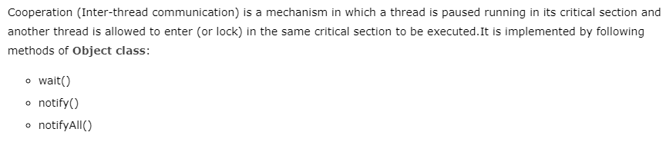
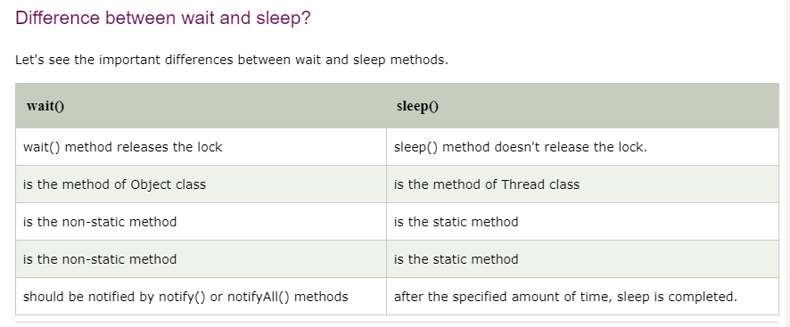

Slide 22

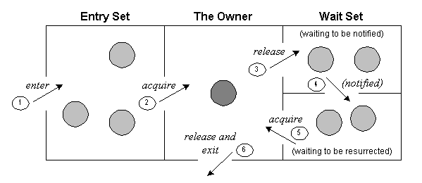
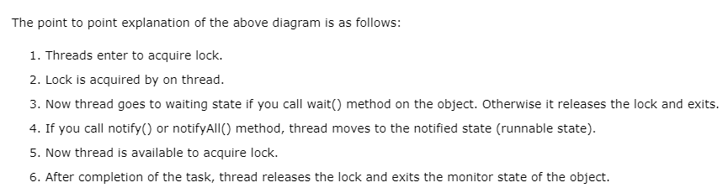

Slide 23
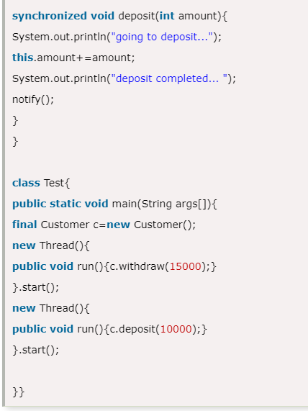
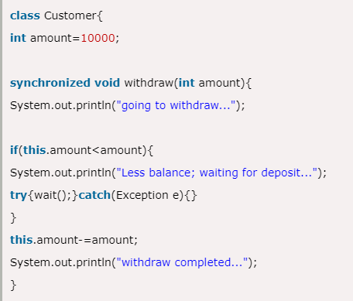
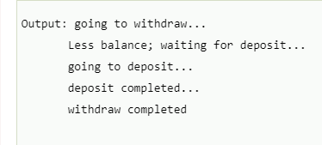

Slide 24

1.4 File IO
The java.io package contains nearly every class you might ever need to perform input and output (I/O) in Java. All these streams represent an input source and an output destination.
Stream
A stream can be defined as a sequence of data. There are two kinds of Streams:
InPutStream − The InputStream is used to read data from a source.
OutPutStream − The OutputStream is used for writing data to a destination.
Most Commonly Used Stream in Java are Byte Streams and Character Streams.

Slide 25
Byte Streams
Byte streams process data byte by byte (8 bits). For example FileInputStream is used to read from source and FileOutputStream to write to the destination.
Character Stream
In Java, characters are stored using Unicode conventions. Character stream automatically allows us to read/write data character by character. For example FileReader and FileWriter are character streams used to read from source and write to destination.
When to use Character Stream over Byte Stream?
In Java, characters are stored using Unicode conventions. Character stream is useful when we want to process text files. These text files can be processed character by character. A character size is typically 16 bits.
When to use Byte Stream over Character Stream?
Byte oriented reads byte by byte. A byte stream is suitable for processing raw data like binary files, image data etc.

Slide 26
import java.io.*;
public class CopyFile {
public static void main(String args[]) throws IOException {
FileInputStream in = null;
FileOutputStream out = null;
try {
in = new FileInputStream("input.txt");
out = new FileOutputStream("output.txt");
int c;
while ((c = in.read()) != -1) {
out.write(c);
}
}finally {
if (in != null) {
in.close();
}
if (out != null) {
out.close();
}
}
}
}
Byte Streams Example
Now let's have a file input.txt with the following content −
This is test for copy file.
As a next step, compile the above program and execute it, which will result in creating output.txt file with the same content as we have in input.txt.

Slide 27
import java.io.*;
public class CopyFile {
public static void main(String args[]) throws IOException {
FileReader in = null;
FileWriter out = null;
try {
in = new FileReader("input.txt");
out = new FileWriter("output.txt");
int c;
while ((c = in.read()) != -1) {
out.write(c);
}
}finally {
if (in != null) {
in.close();
}
if (out != null) {
out.close();
}
}
}
}
Now let's have a file input.txt with the following content −
This is test for copy file.
As a next step, compile the above program and execute it, which will result in creating output.txt file with the same content as we have in input.txt.
Character Stream Example

Slide 28
RandomAccessFile Class
This class is used for reading and writing to random access file. A random access file behaves
like a large array of bytes.
Java RandomAccessFile provides facility to both read and write data to a file.
RandomAccessFile works with file as large array of bytes stored in the file system and a cursor using which we can move the file pointer position.
If end-of-file is reached before the desired number of byte has been read than EOFException is thrown. It is a type of IOException.
Constructor | Description
RandomAccessFile(File file, String mode) | Creates a random access file stream to read from, and optionally to write to, the file specified by the File argument.
RandomAccessFile(String name, String mode) | Creates a random access file stream to read from, and optionally to write to, a file with the specified name.

Slide 29
import java.io.*;
public class RandomAccessFileDemo {
public static void main(String[] args) {
try {
// create a new RandomAccessFile with filename test
RandomAccessFile raf = new RandomAccessFile("c:/test.txt", "rw");
raf.writeUTF("Hello World"); // write something in the file
raf.seek(0); // set the file pointer at 0 position
System.out.println("" + raf.readLine()); // print the line
raf.seek(0); // set the file pointer at 0 position
raf.writeUTF("This is an example \n Hello World"); // write in the file
raf.seek(0);
System.out.println("" + raf.readLine()); // print the line
} catch (IOException ex) {
ex.printStackTrace();
}
}
}
Assuming we have a text file c:/test.txt, which has the following content. This file will be used as an input for our example program −
ABCDE
Let us compile and run the above program, this will produce the following result −
Hello World
This is an example

Slide 30
2. WAP to Copy files using i/o streams
import java.io.FileInputStream;2.
import java.io.FileOutputStream;
class Main {
public static void main(String[] args) {
byte[] array = new byte[50];
try {
FileInputStream sourceFile = new FileInputStream("input.txt");
FileOutputStream destFile = new FileOutputStream("newFile");
// reads all data from input.txt
sourceFile.read(array);
// writes all data to newFile
destFile.write(array);
System.out.println("The input.txt file is copied to newFile.");
}
catch (Exception e) {
e.getStackTrace();
}
finally {
sourceFile.close();
destFile.close();
}
}
}
Output
The input.txt file is copied to newFile.

Slide 31
Important Questions
Why concept of interface is important? How multiple-inheritance is supported by interface? Explain with suitable example. [Model Q/2069/2070/2071] [10]
What are exceptions? Why is it important to handle exceptions ? Discuss different keywords that are used to handle exception. [Model Q/2069/2070] [10]
Write a program to read ID, Name, address, salary of twenty students from keyboard and write in into the file “emp.doc”. Again read records of the employees and display records of those students whose salary is more than 25000. [Model Q] [10]
What is multithreading? Why is it important to develop computer programs? Discuss life cycle of thread in detail. [2070/2071][10]
Write a simple java program to read from and write to files. [2071][5]

